Slide 1
Project 9: EKF-based Localization with LRF
Presentation 3:
Simulation, Coding and Problems
Notes:
This is the third presentation about our project. Project number 9: Extended Kalman Filter based Localization using a Laser Range Finder

Slide 2
Outline
Progress
Mapping
Simulation
EKF Node
Outlook
Questions
Notes:
This is the outline of my presentation.
I am going to start with the progress we were able to achieve since the last lab. Therefore, I am going to talk about mapping, about our simulation setup, and about some coding aspects.
In the second part of the presentation I am going to give you a short outlook on our plan for the next weeks before finishing with question we have right now.

Slide 3
Outline
Progress
Mapping
Simulation
EKF Node
Outlook
Questions
Notes:
So progress:

Slide 4
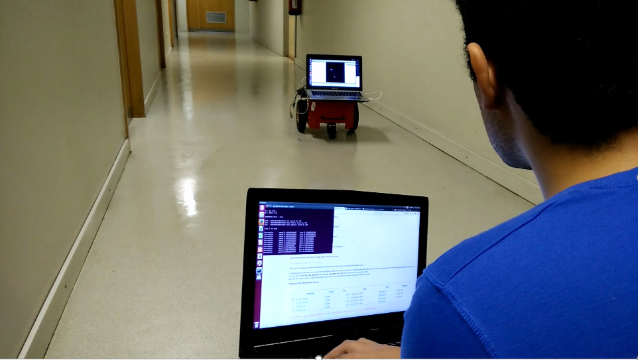
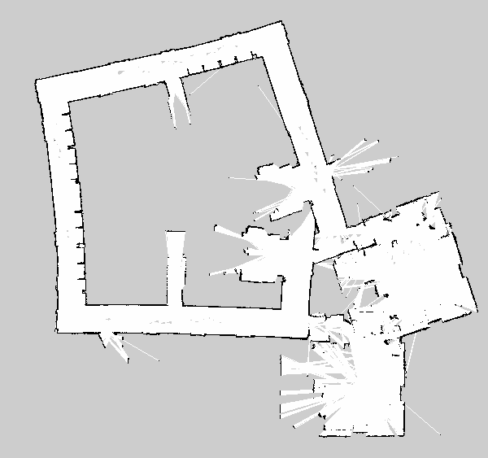
Progress (1)
3 weeks ago:
ROSARIA, Odometry, LRF and RVIZ
Mapping with gmapping
Remote controlling
Next step: Coding EKF
LRF
Matching
Improve!
Prediction
Update
Odometry
Observation model
Map
Notes:
This is a brief summary of what was our situation three weeks ago. We already had the fundamental parts of the robot and ROS working. That included ROSARIA, the odometry, the LRF and RVIZ. We were able to obtain maps by remote controlling the robot and using the gmapping package
While mapping we had problems with the odometry being poorly calibrated, so that the results, like the shown map here, were not satisfying. Our idea was to implement the EKF in the next step. Although we later found out it would not be that easy. So what did we achieve in the last 3 weeks?

Slide 5

Progress (2)
Today:
Preperation for implemention of EKF
Gazebo with world map, Pioneer 3DX and LRF
Publisher and subscriber python code
Improved map
Faced a lot of problems with gazebo & the mapping
Not as much progress as planned
Everything is prepared for implementing EKF
Notes:
We did a lot of preperations for implementing the EKF. We installed the gazebo simulation package and included our real world setup there. That includes the 5th floor map, the Pioneer and the LRF.
So we are now able to simulate the robot and can test all the implementations we will make.
Additionally we already tried some Python code for subscribing and publishing topics. To be honest, nothing too spectacular but still a solid base for implementing the EKF.
Then we also spend some time on improving the obtained map.
In general we faced a lot of problems with making gazebo work and also lost some time on improving the map. *CLICK*
That is why we do not have as much progress as we hope we would have. *CLICK*
But now everthing should be well prepared for implementing the EKF and we hope we can now fastly progess in this part.

Slide 6
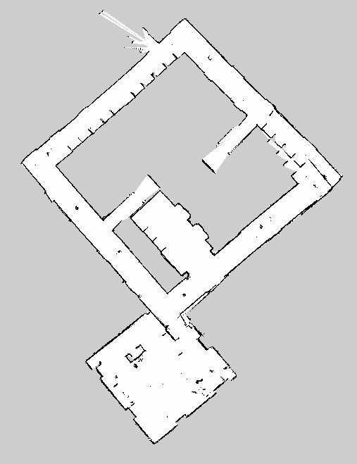
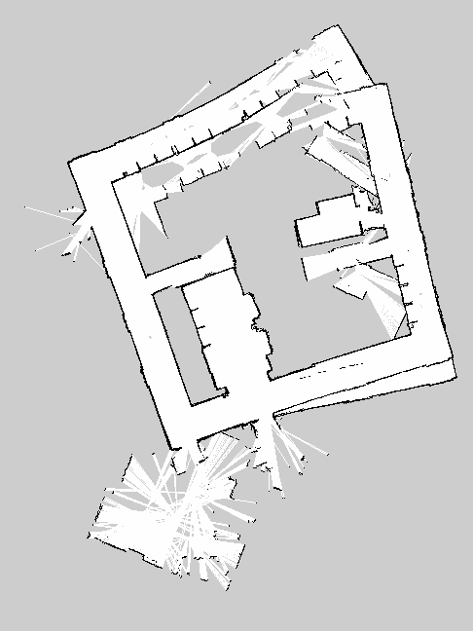
Mapping
Old map:
New map:
Notes:
Here is the result of the time we once again spend into mapping.
On the left side one of the older maps is shown.
There obviously are a lot of areas that we would not be able to use, because they just are do not represent the reality well enough.
In the improved map only the corner on the right may cause trouble. But we think we should be fine as long as we avoid this part of the map.
To improve the map we used the same technique as one of the other groups: Placing more objects on the straights to add more references for the robot.
The objects we used are now visible on the map. Depending on the how we will use the map, we maybe will optimise the map with a graphic editor or similar software and then delete the objects there.

Slide 7

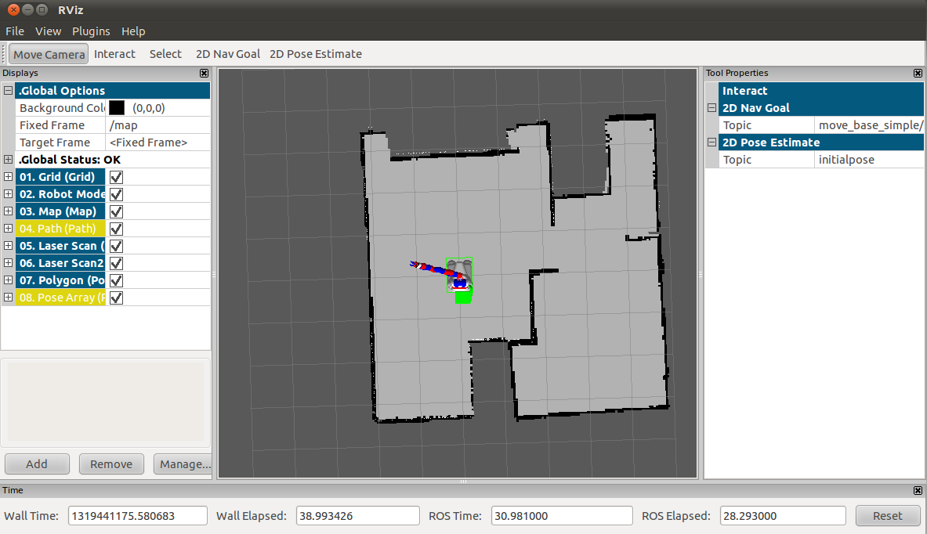
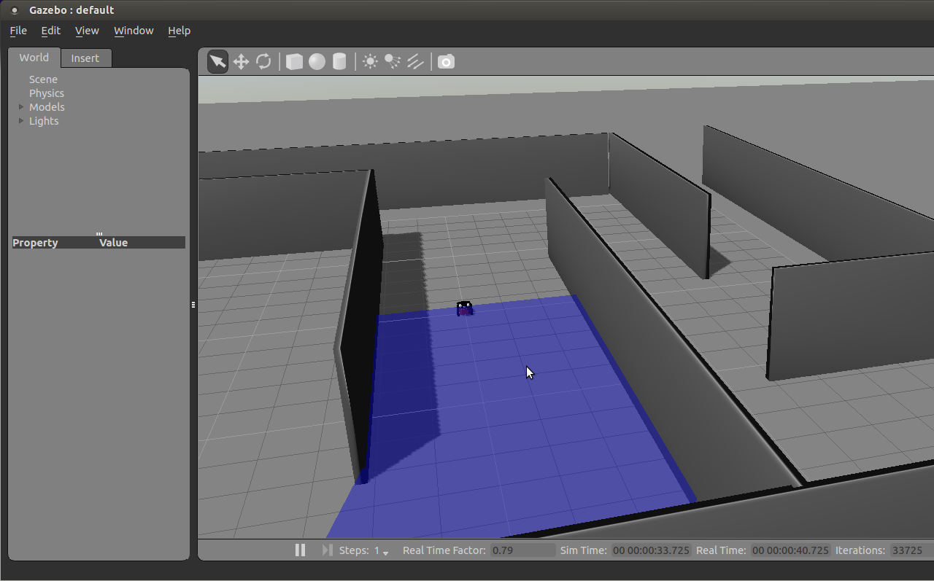

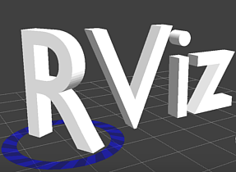

Simulation (1)
Notes:
Now we would like to show you how our simulation setup works. Before doing so a brief explanation.
We made a launch file that launches Gazebo with our map and our robot model with a laser
The launch file launches also the Rviz with the topics of the map and the robot model just like we would do with the real robot.
In the end we would use the Teleop program to move the robot around. Because we use a pioneer 3dx, a LRF model and a rebuilded 5th floor map on gazebo, the data in RVIZ is comparable to that from the real robot.

Slide 8
Simulation (2)

Slide 9
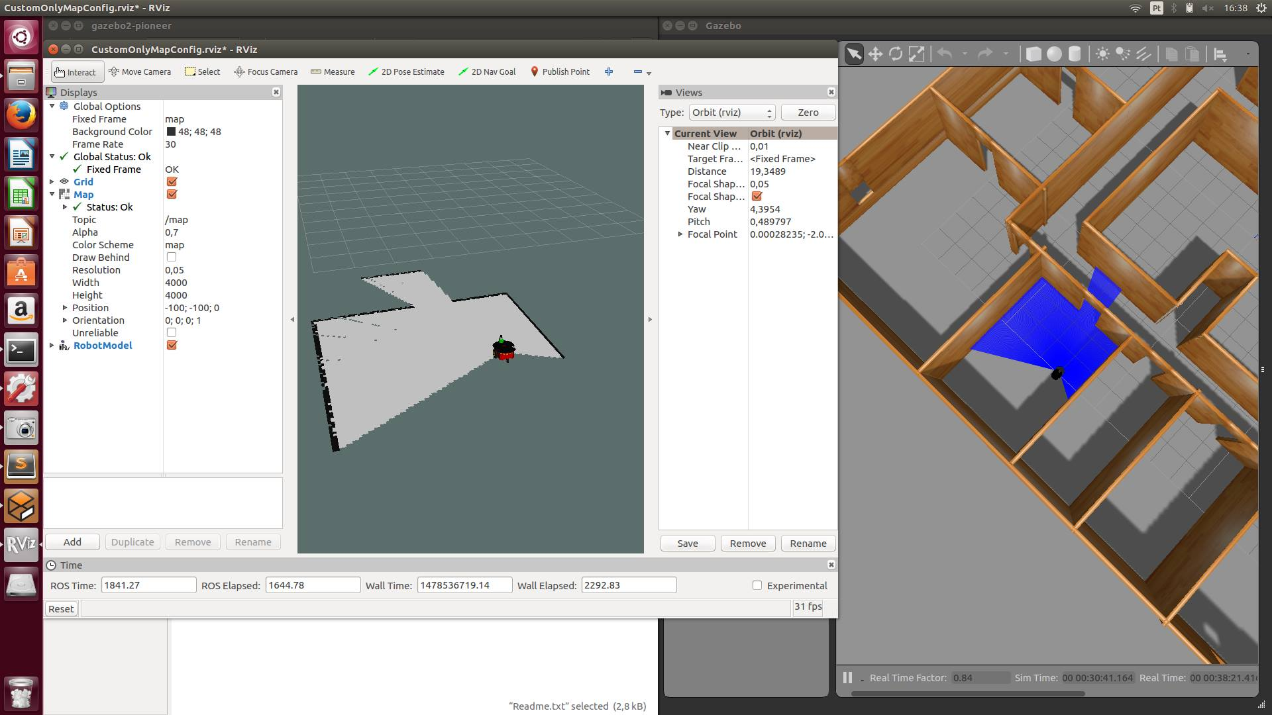
Simulation (3)
Backup:

Slide 10
EKF Node (1)
Black box development approach
Python code for subscribing to LaserScan & Odometry topics
Fixed the synchronisation problem by using flags & queue size = 0
Python code for publishing
Notes:
In terms of coding we started by using a Black Box development approach.
We began with developing code to subscribe to the LaserScan and Odometry topics. When we did this we noticed that there might be synchronization problems due to communications arriving late or storing data in the queue.
To solve this we resorted to flags that were activated when we received the data and were cleaned after the EKF´s main cycle.
The queue size we set to 0 so that we only keep the most recent data.
We also made the code for publishing topics and got it working and saw the data on Rviz

Slide 11
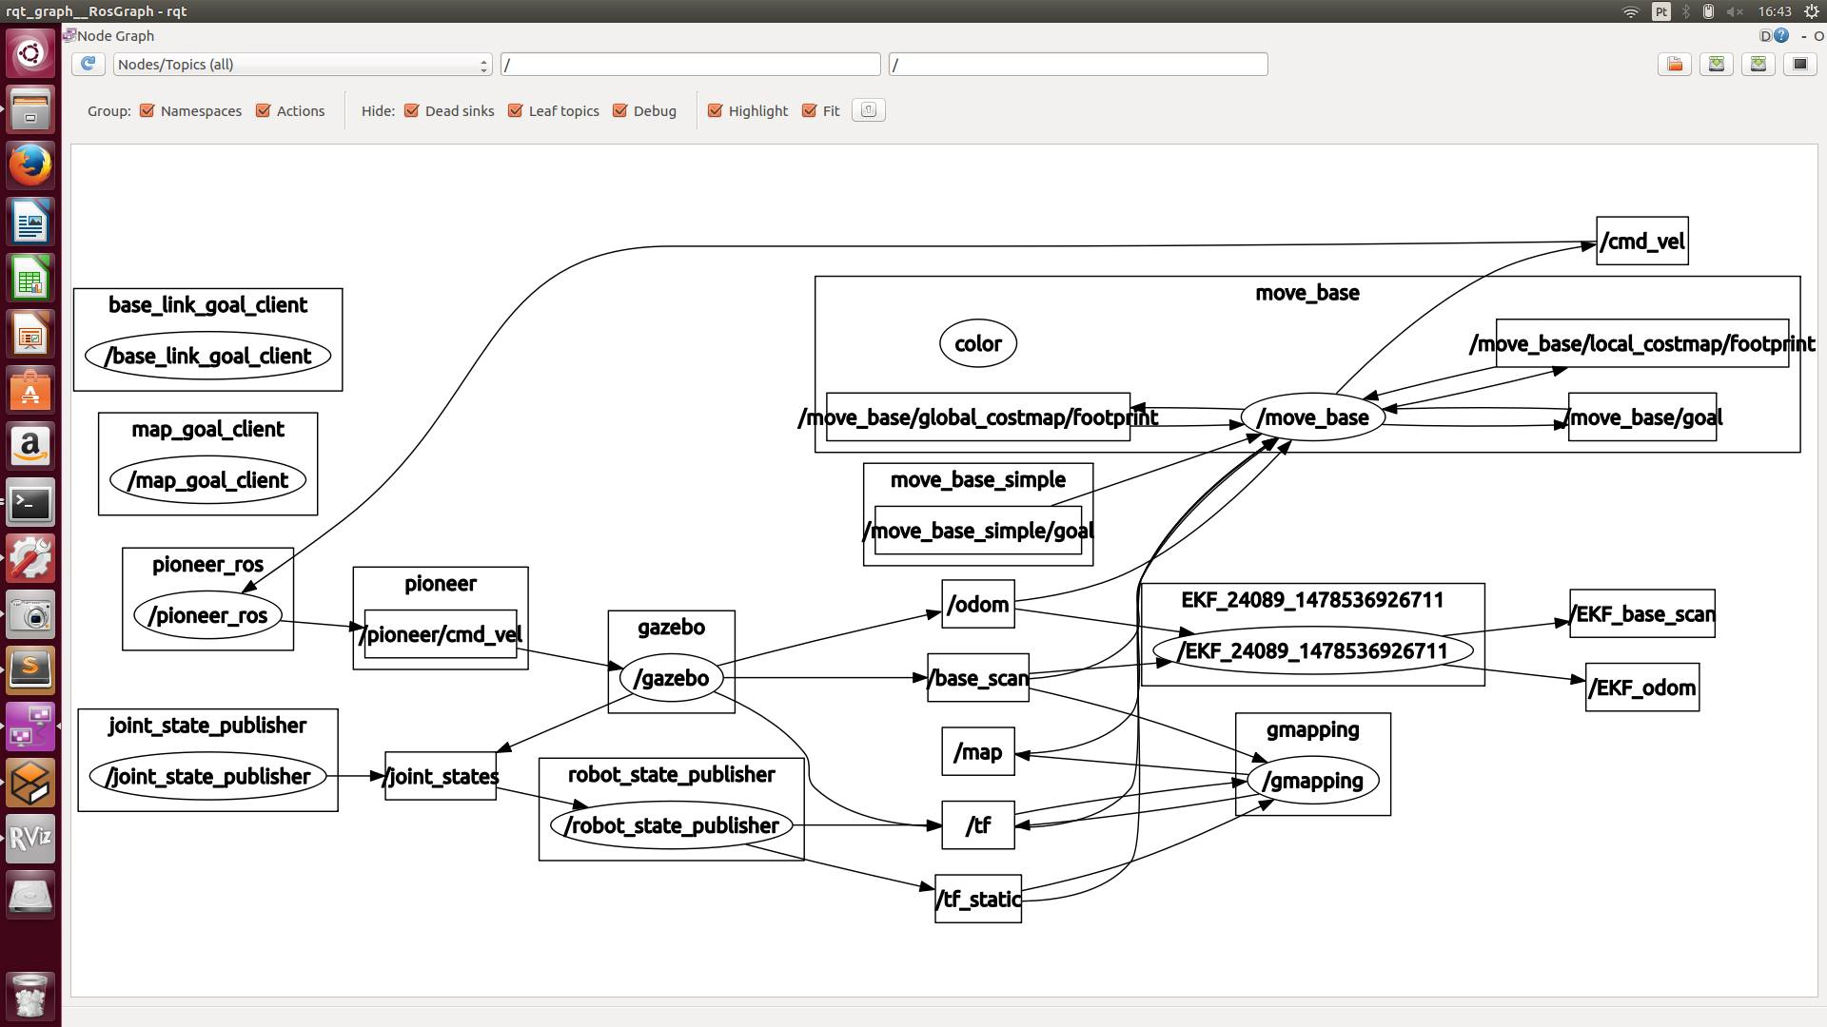
EKF Node (2)
Backup:

Slide 12
Outline
Progress
Mapping
Simulation
EKF Node
Outlook
Questions
Notes:
So how will we continue our work on the project?

Slide 13
Outlook
LRF
Work in progress!
Matching
Prediction
Update
Odometry
Observation model
Map
Based on the EKF localization slides
Notes:
Currently, the prediction part of the algorithm is work in progress, and since we had a lot of doubts it still isn´t coded and working. In the next steps we will develop the Update part and then the Matching at last.

Slide 14
Outline
Progress
Mapping
Simulation
EKF Node
Outlook
Questions
Notes:
We have a few questions for the teacher

Slide 15
Questions
Working with points or with line segments?
Where will we review the EKF results?
Should we use landmarks?
Do we really need the Odometry in the Prediction module of the EKF? Isn´t the Observation enough?
How will get expected observations out of the map?

